Slide 1
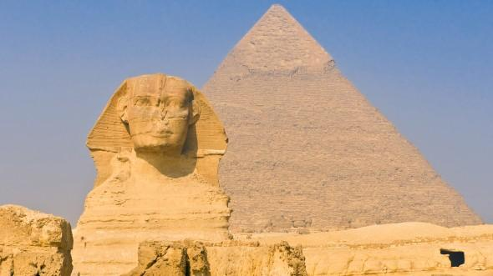
Exciting Egypt!
By F J

Slide 2
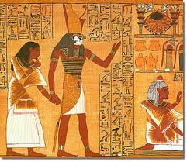
Contents
Facts about Egypt
Where is Egypt
People and Culture
Ancient Egypt
More Fun facts about Egypt
My trip to Egypt
Quiz

Slide 3
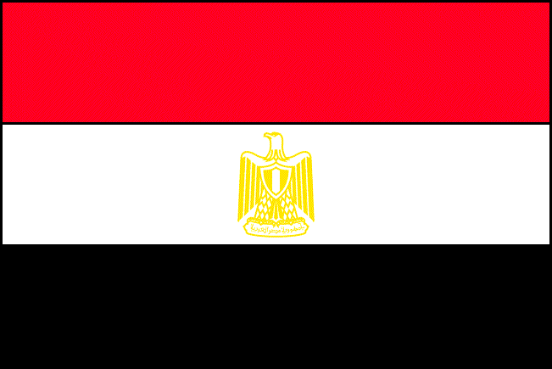
It’s real name is: Arab Republic of Egypt.
Their language: Arabic
Size of Egypt: 386,662 square miles
Facts about Egypt
Biggest River: The Nile
Mountains: the Highlands
Money: Egyptian pound
The capital of Egypt is Cairo
Population: 78,887,007

Slide 4
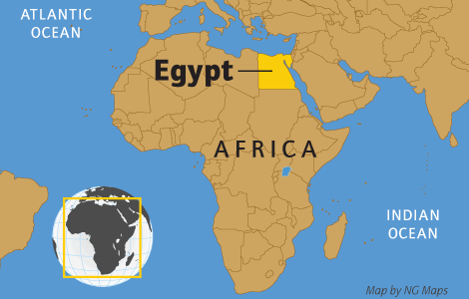
Where is Egypt
Egypt is in the Northeast corner of Africa

Slide 5
90 % of Egyptians are Muslim.
10 % of Egyptians are Copts, one of the oldest Christian religions.
Egypt's population is growing really quickly. A problem as too many people are living in little spaces.
People and Culture
Children work hard. They help their parents with their work. Children are also expected to look after their parents in their old age
Egypt gets most of its money from tourism.
Visitors come to the country to see ancient monuments.

Slide 6
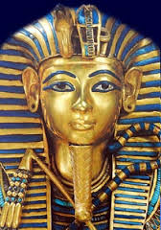
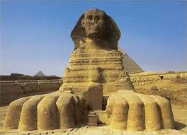
The first people to live on the banks of the Nile were hunters and fishermen, who settled there over 8,000 years ago.
They learned to grow crops and raise animals, and they began to build villages and towns.
Around 3100 B.C., the kingdoms of Upper and Lower Egypt were ruled under a powerful king, later called a pharaoh. These kings built huge pyramids, temples, and other monuments. They also took over other lands.

Slide 7
More Fun facts about Egypt
1. Most Ancient Egyptian pyramids were built as tombs for pharaohs and their families. 130 pyramids have been discovered in Egypt.
2. The afterlife was incredibly important to the Egyptians. They believed that by preserving a dead person's body - their soul would live on in the after-life forever.
3. The Pyramid of Khufu at Giza is the largest Egyptian pyramid. It weighs as much as 16 Empire State buildings!
4. Both Egyptian men and women wore makeup. The eye-paint was usually green or black. As well as offering protection from the sun, the Egyptians believed makeup had magical healing powers, too!
5. Unwrapped, the bandages of an Ancient Egyptian mummy could stretch for 1.6km.

Slide 8
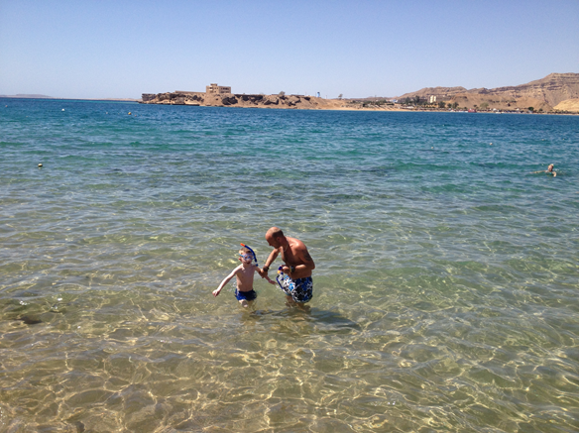
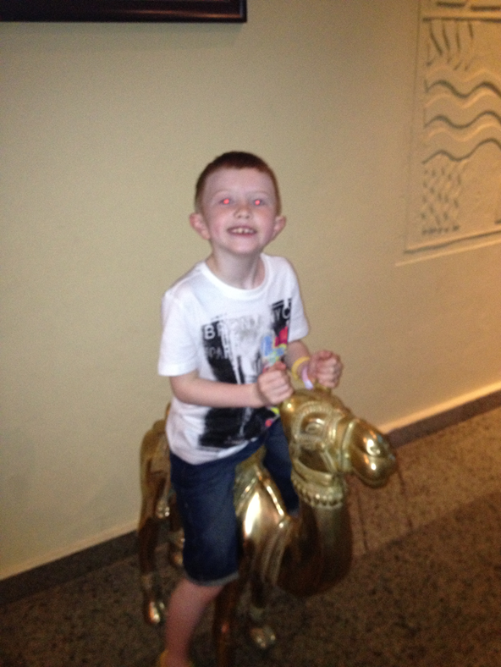
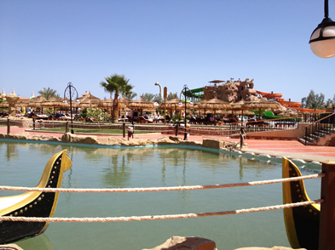
My trip to Egypt
In 2013 I went to Egypt on holidays. I stayed at Sharm El Sheikh. The hotel was fab! It had 11 swimming pools and over 40 slides!
It took us over 4 hours to get there by aeroplane. It was very hot. Over 30 degrees celcius!

Slide 9
Quiz Time
What was the Egyptians favourite animal?
What was the name of the plant they use to make paper with?
How old was Tutankhamen when he became king?
What river runs through Egypt?
Where is Egypt?
How many Pyramids have been discovered in Egypt?
Who wore make up in Ancient Egypt?
How heavy is the largest pyramid?

